Slide 1

Time Series Analysis and Machine Learning
For
Sales Prediction
Zabihullah Zabih

Slide 2
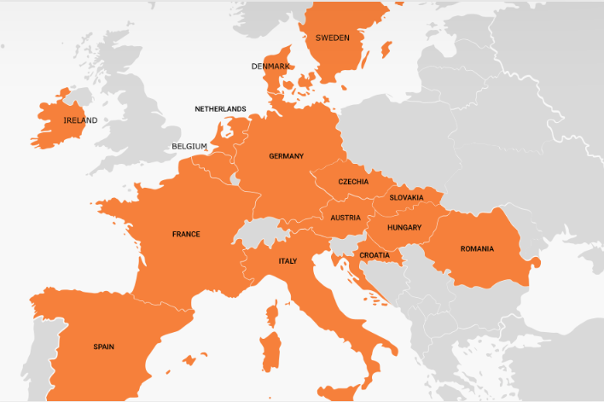
A Bit About Top4Sport:
Sells Sport Equipment in Fifteen European Countries.

Slide 3
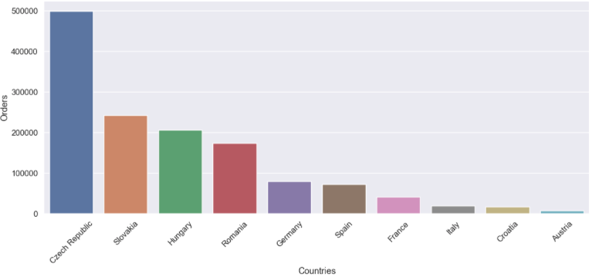
Analysis Results
Data Received for Analysis:
Ten Countries
Twenty-Three Months

Slide 4
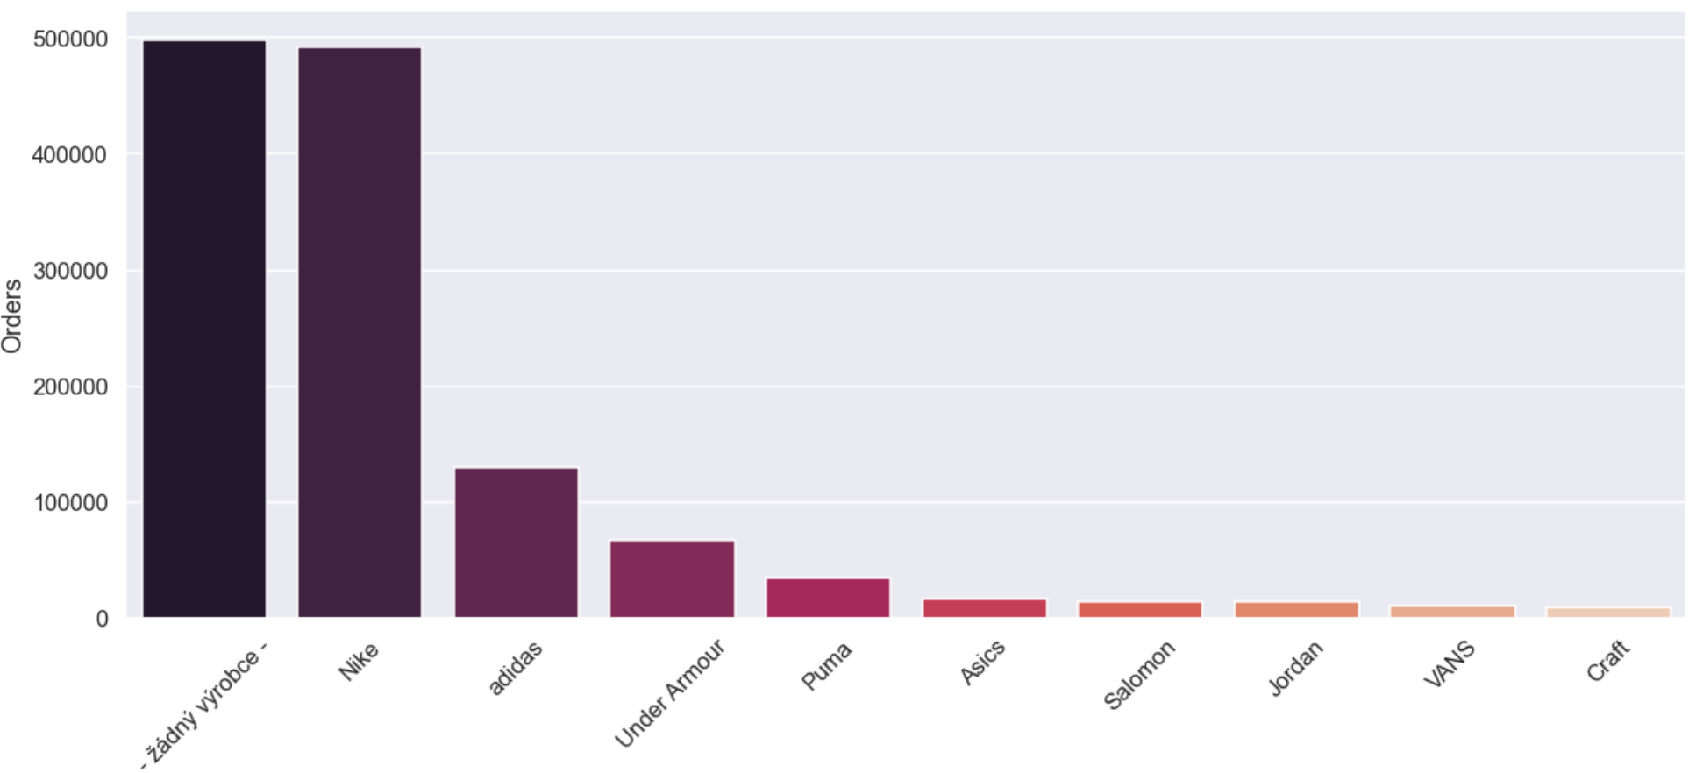
Brand Preferability of its Customers:

Slide 5
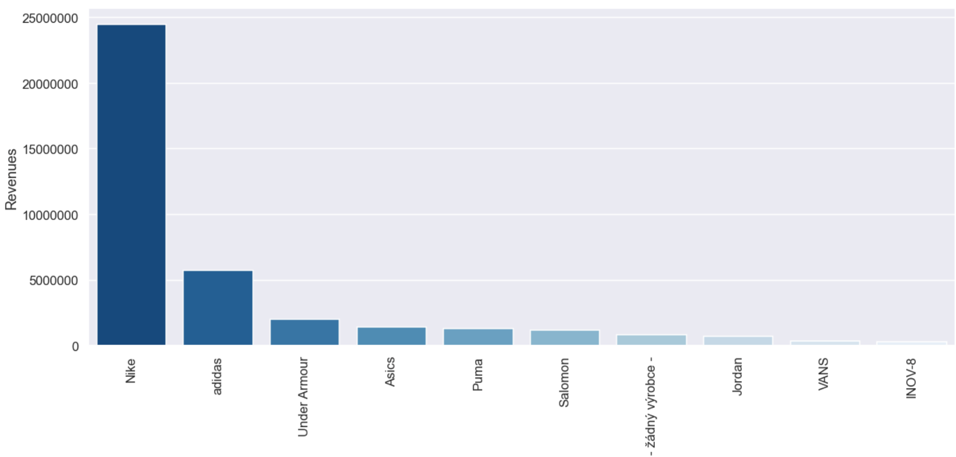
Orders Vs Revenues

Slide 6
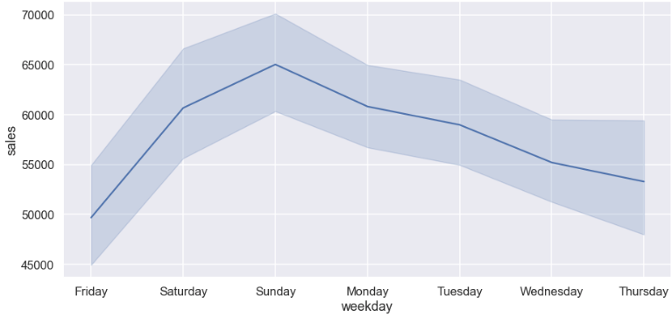
Sales Analysis:
Weekly Sales Distribution

Slide 7
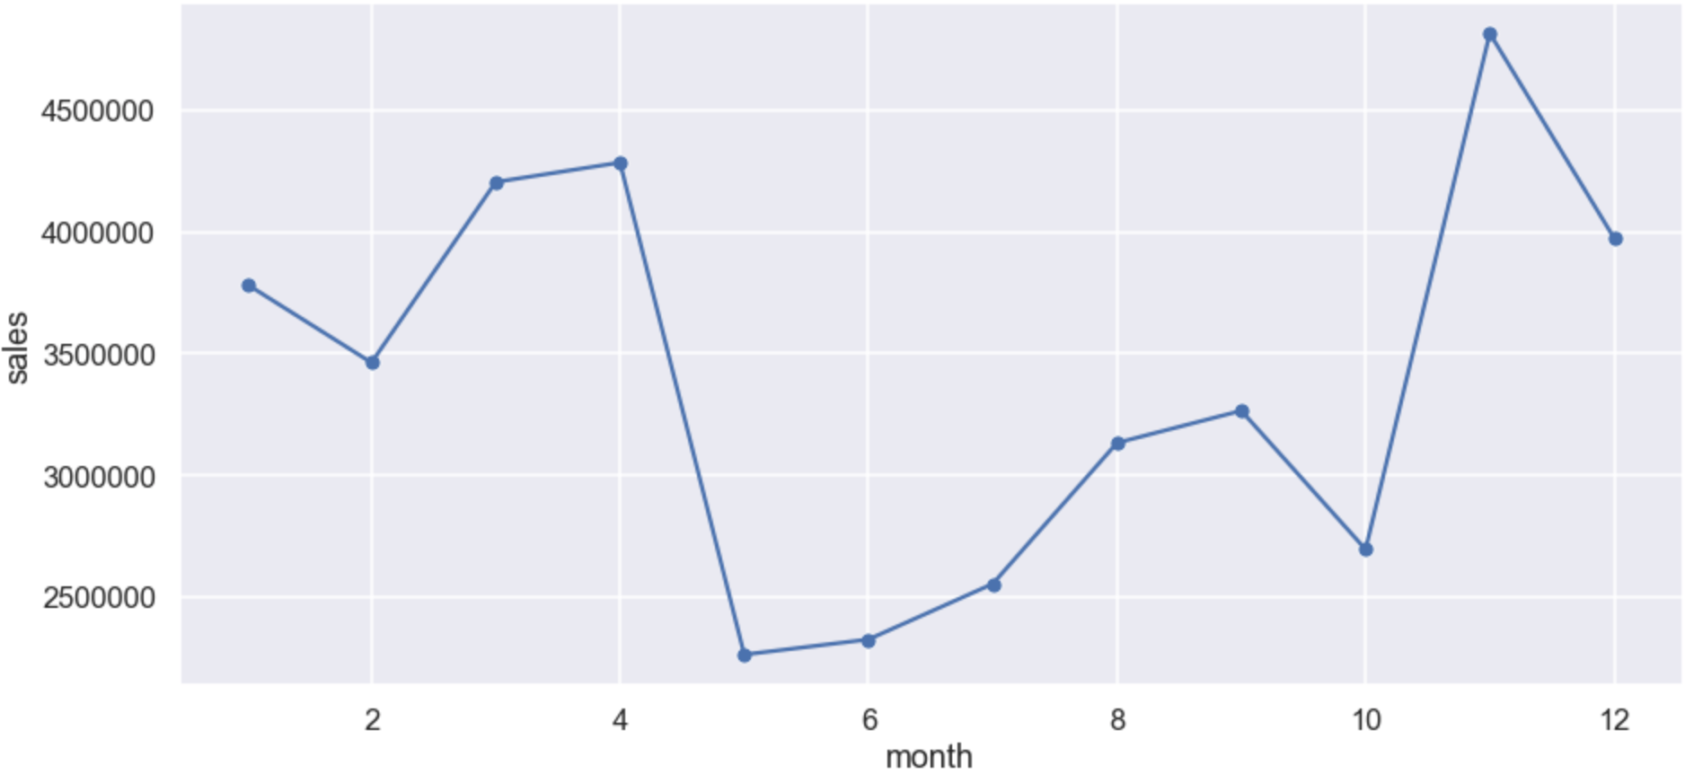
Sales Analysis:
Monthly Sales Distribution

Slide 8
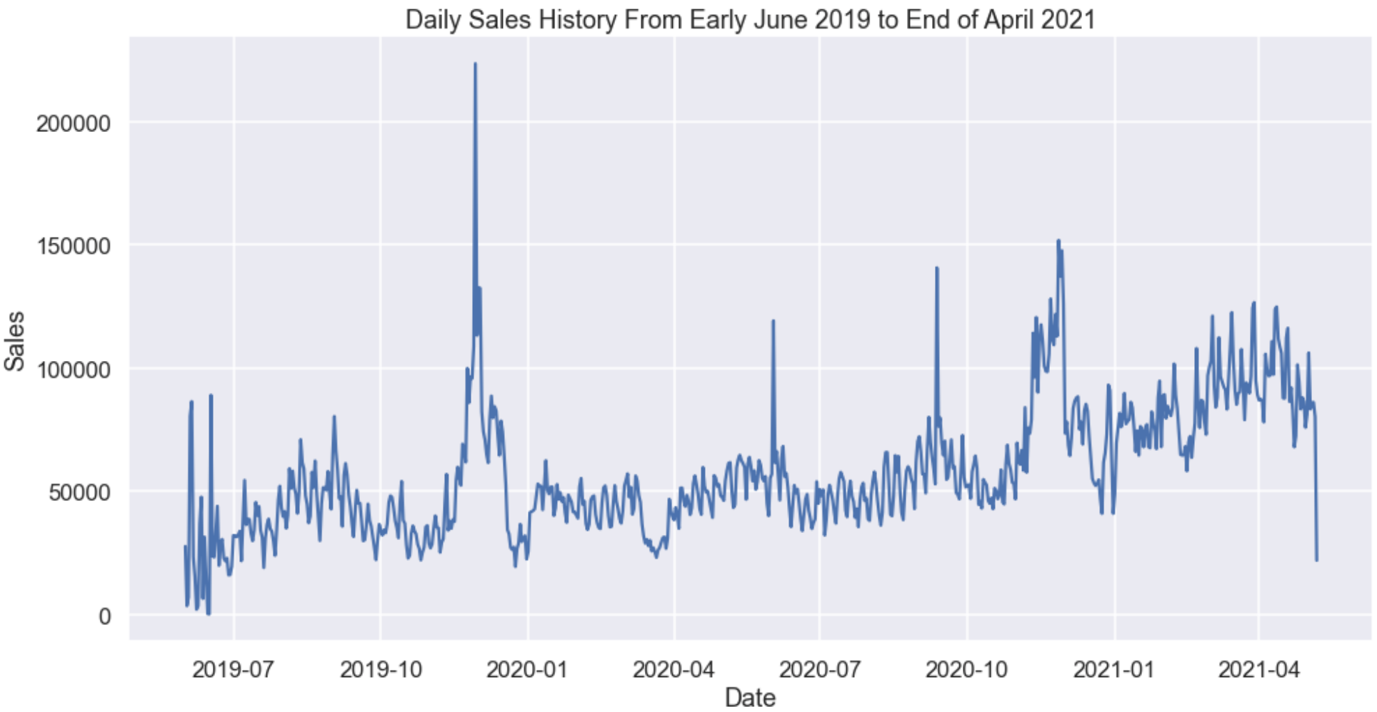
Sales Analysis

Slide 9

Sales Prediction

Slide 10
Machine Learning
Trained Models :
XGBoost
Fbprophet
LSTM
Simple Neural Network
Provide a more accurate forecast
Analyze more data
Identify hidden patterns in data

Slide 11
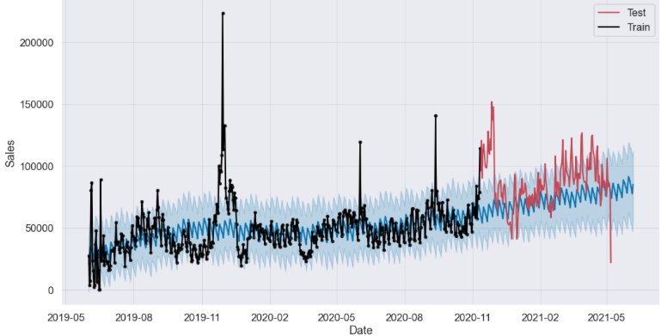
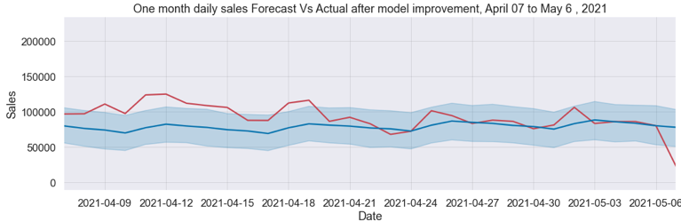
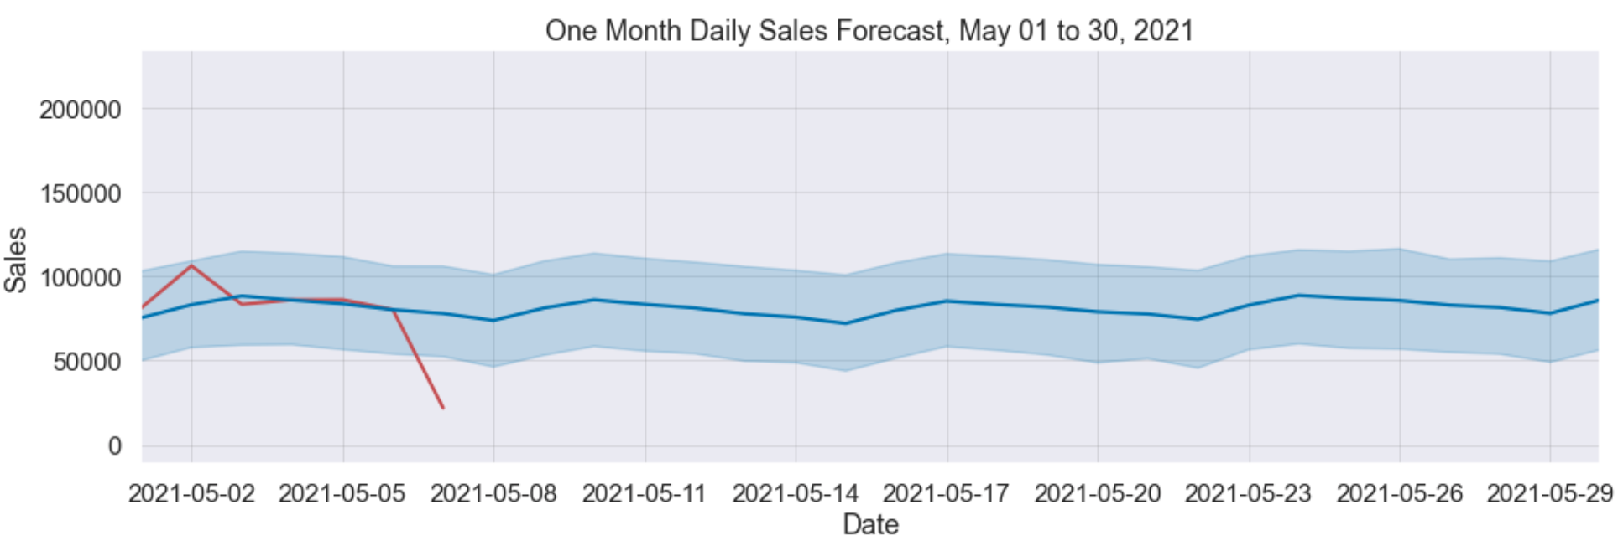
Daily Sales Forecast
MAPE: Twenty percent

Slide 12
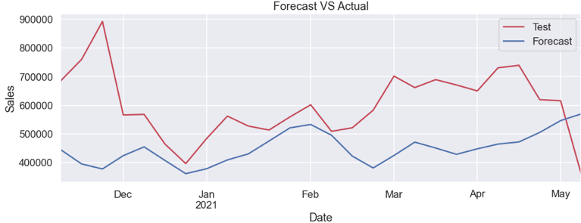
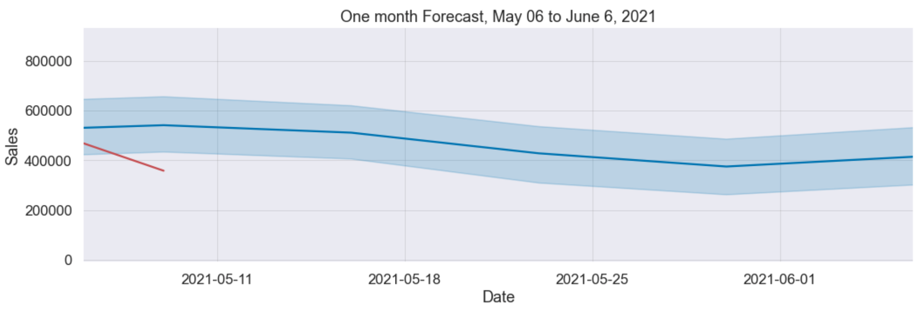
Weekly Sales Forecast
MAPE: Twenty Six percent

Slide 13
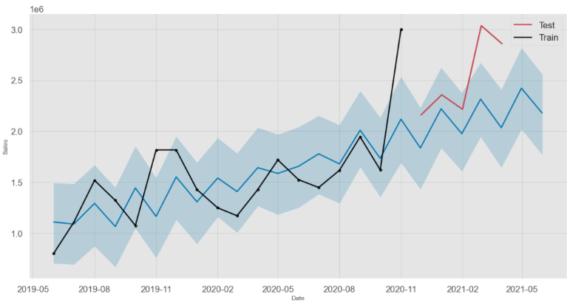
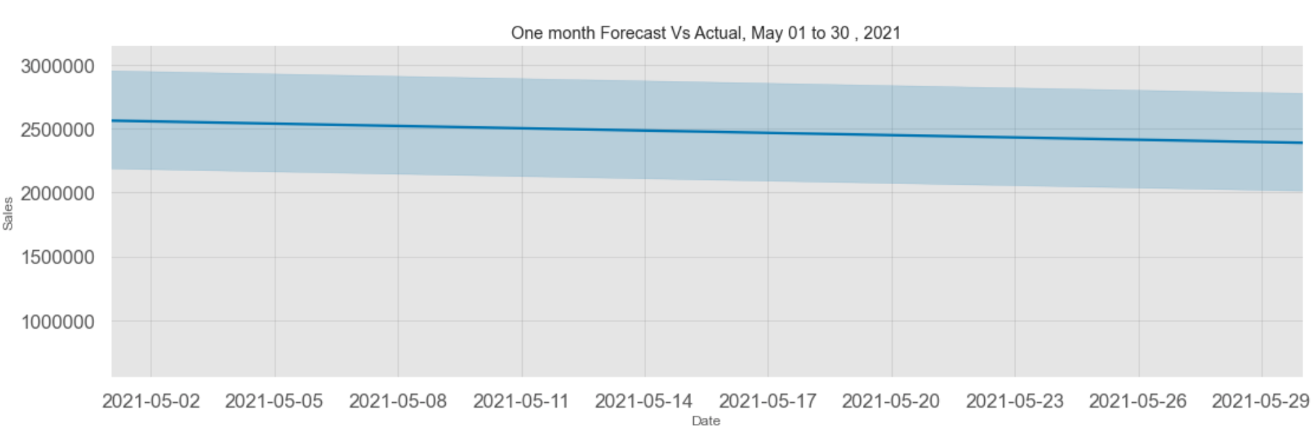
Monthly Sales Forecast
MAPE: Sixteen percent

Slide 14
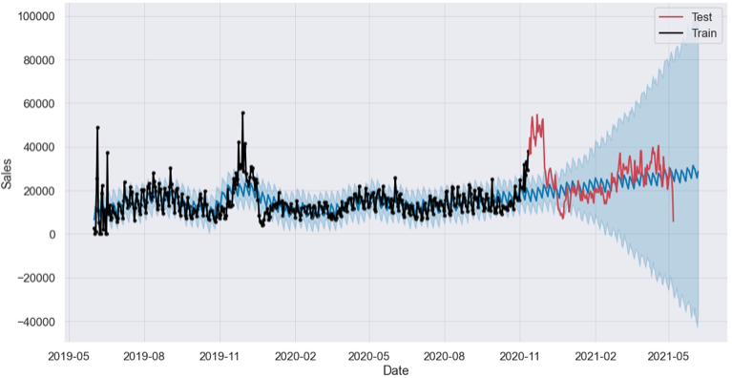
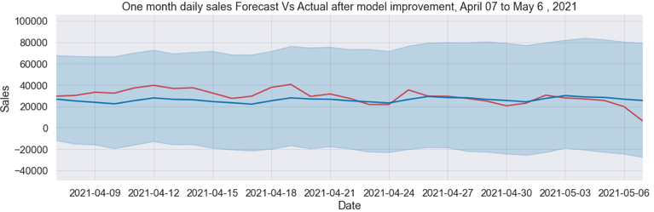
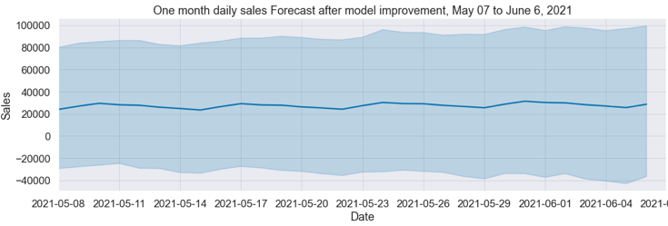
Daily Sales Forecast for Czech
MAPE: Twenty Nine percent

Slide 15
Objective of Sales Prediction:
Supplier
Relationship
Management
Customer
Relationship
Management
Marketing
Campaigns

Slide 16
What Next?
To Improve Prediction Accuracy:
Weather Data
Holidays
Bigger Dataset with Longer History
Social Media Data
Website Reviews

